Slide 1
As One Listens to the Rain
Presented by:
Shruti Uniyal – 1740859
Vagisha Pandey - 1740866

Slide 2
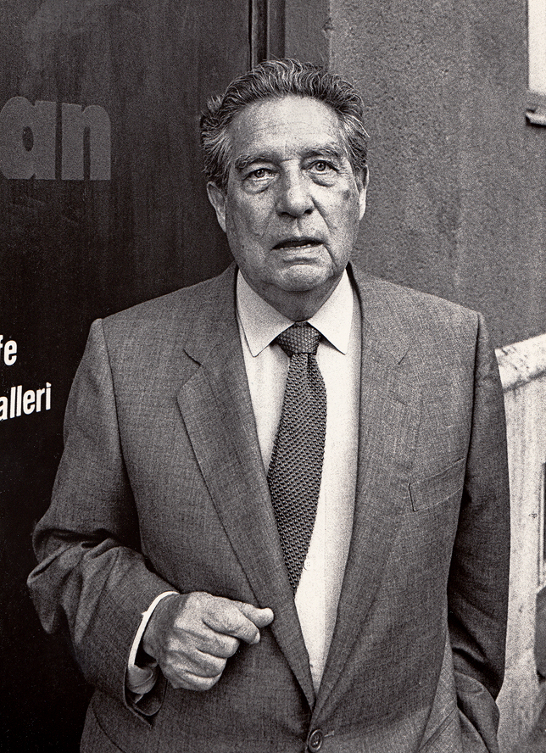
Octavio Paz
Born March 31, 1914
Mexican poet and diplomat
Nobel Prize in literature in 1990
One of the most prominent Latin American
Poets of the 19th century, famous for : As
One Listens To The Rain, Between Going &
Staying, No More Cliches

Slide 3
Analysis
Tone
Title
Structure
Language
Imagery

Slide 4
Tone of the Poem
Very Peaceful tone
Almost as though he is meditating; almost in a trance
Speaker is observant of nature. Observes the rain and urges listeners to listen to him as one sub-consciously and effortlessly listens to the rain.

Slide 5
Title of the Poem
Significance of the title of the poem -
Tone with which the poem has been written
Emotions captured in the poem
Themes of nature’s beauty incorporated

Slide 6
Themes: Rain
Centrepiece of the poem
Is like a constant background image/sound throughout the poem
One doesn’t try to comprehend the sound of the rain.
They just listen to it and accept it.

Slide 7
Themes: Nature and Beauty
Speaker is quite observant of nature
Seen through the Imagery and Figurative language throughout the poem

Slide 8
Themes: Continuity
Day is still leaving – Night is yet to arrive
Figurations of time at the turn of the corner
Relation between air, water and time
Get into the flow of the poem

Slide 9
Structure
One full stop – one sentence
Speaker is deep in thought ; almost in a meditative trance.
Thoughts flow
Poem written in free verse
No division between his thoughts and his feelings
Open to interpretation

Slide 10
Analysis
Calmness-“Listen to me as one listens to the rain
Not attentive, not distracted”
Transition from Longingness to Calmness –
Asking for love and attention – “Listen to me”
“footsteps of water across my eyes”

Slide 11
Spiritualism – “you are you and your body of steam”
“with eyes open inward, asleep
with all five senses awake”
Time – “the years go by, the moments return
do you hear the footsteps in the next room?
not here, not there: you hear them
in another time that is now,
listen to the footsteps of time”

Slide 12
Romanticism –
-“you are you and your body of steam,
you and your face of night,
you and your hair, unhurried lightning”
- The use of “I”, ”me”, ”us”

Slide 13
Literary Devices
Simile – “As one listens to the rain”
Repetition – “Listen to me as one listens to the rain”
Metaphor – “light footsteps, a murmur of syllables”
– “you and your body of steam
you and your face of night”

Slide 14
Literary Devices
Imagery – “Light footsteps, thin drizzle”
– “it's raining, light footsteps, a murmur of syllables,
– “Wet asphalt is shining,
steam rises and walks away”

Slide 15
Thank you

